Slide 1
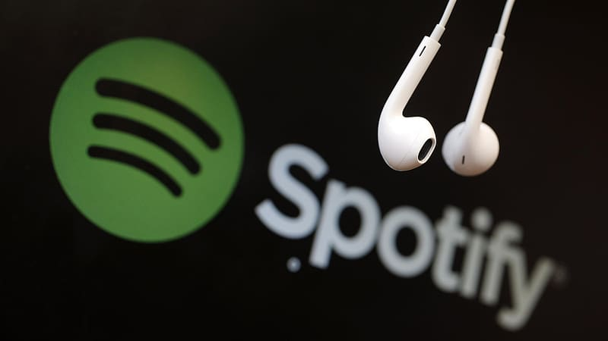
Spotify Trend analysis
CAPSTONE PROJECT
BY RAGHAVI NIRANJANI E

Slide 2

Spotify – Most audio streaming platform in the world.
To Transform Spotify raw data into interactive visualization.
To recommend marketing strategy focusing on advertising to stay competitive in music industry.
Spotify data could be useful for a myriad of business purposes, particularly in adverstising.
The dataset contained for 3 years (2017 to 2019) – Date, popularity, artist, country, Position, Streams.

Slide 3

Problem:
To analyze the Spotify trends and create data visualizations using tableau
Business Task:
To suggest recommendation on advertisement technique to stay competitive in industry.

Slide 4
Business Questions???
How can we streamline the process for selecting songs for advertisement??
2. How can artist better understand their popularity in different regions
across the globe using spotify data??
How can both parties use stream trends to discern whether a song is
still popular??

Slide 5
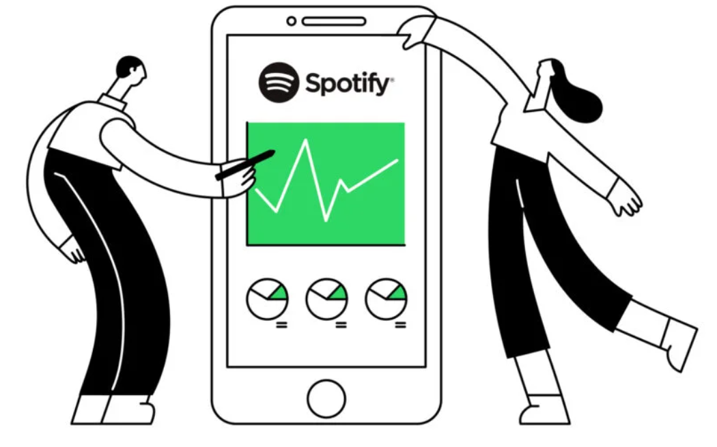
METHODOLOGY:
Data Cleaning and Manipulation
2. Data Analysis
3. Data Visulaization - Tableau

Slide 6

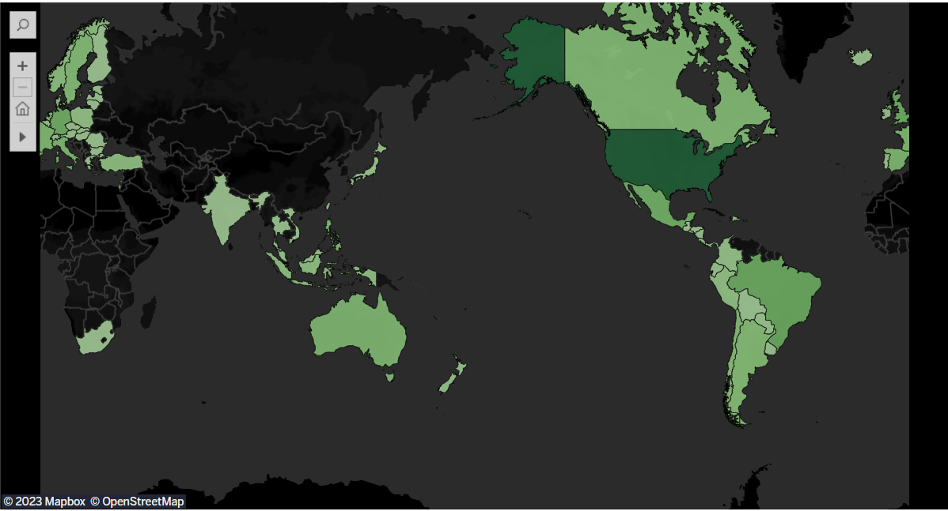
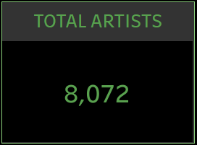
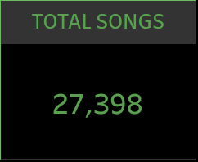

Popularity over Countries
United States has largest streaming of 8 Billion.

Slide 7

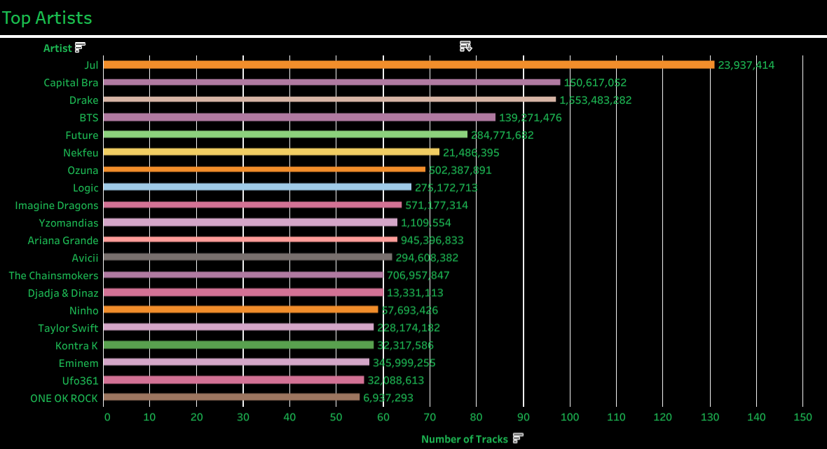
This graph shows popular artist from 2017 to 2019. Jul tops among all artist with most tracks.
Note that the artist with most tracks may not have most streams.

Slide 8

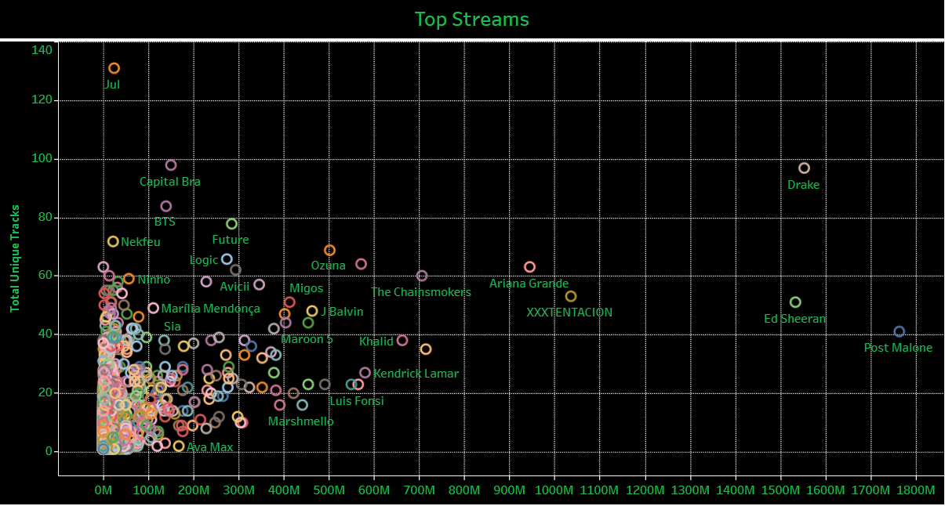
Top stream is represented in terms of track and artist.
Post Malone got the highest streaming.
Drake consistently has lot of tracks and also has lot of steam time.

Slide 9
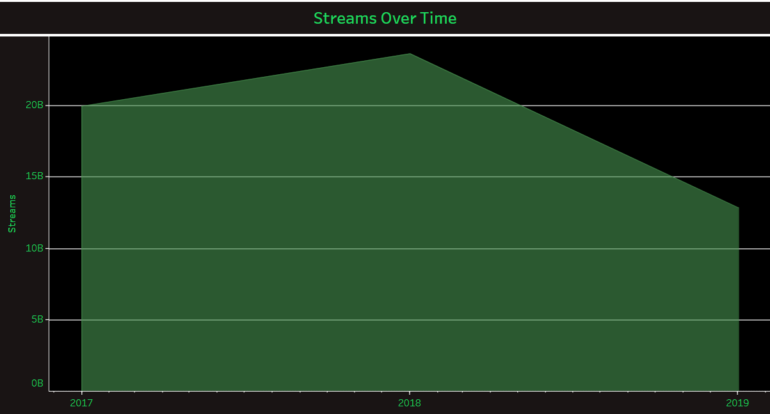
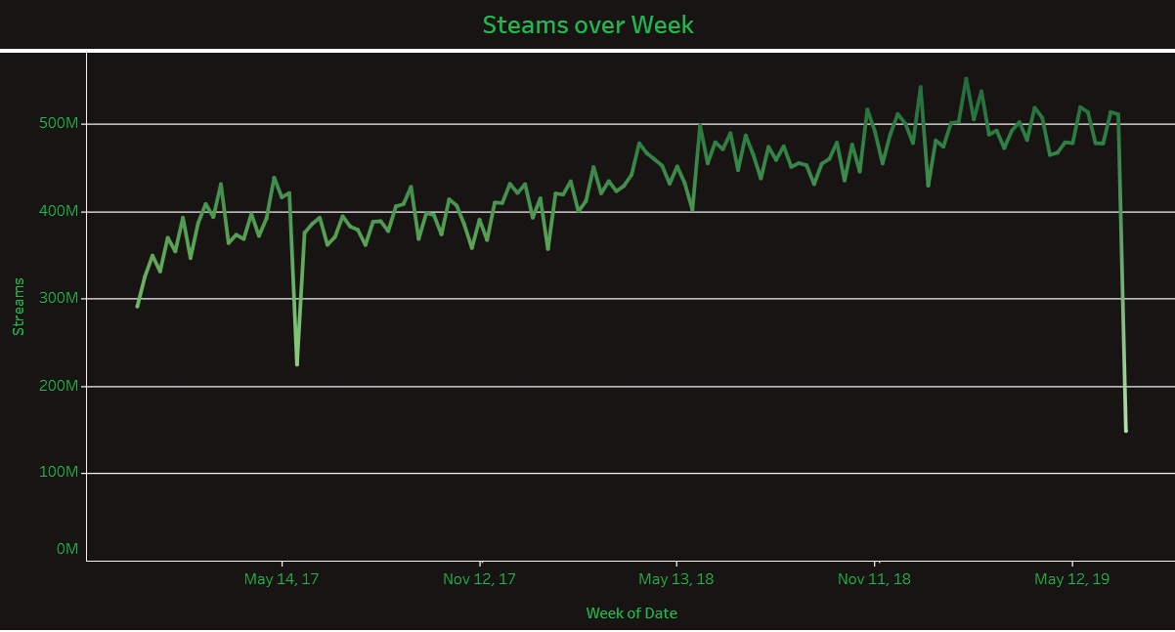
Challenge – indicates a decrease in streaming in the year 2019. Decline in the popularity or usage of Spotify during that period

Slide 10
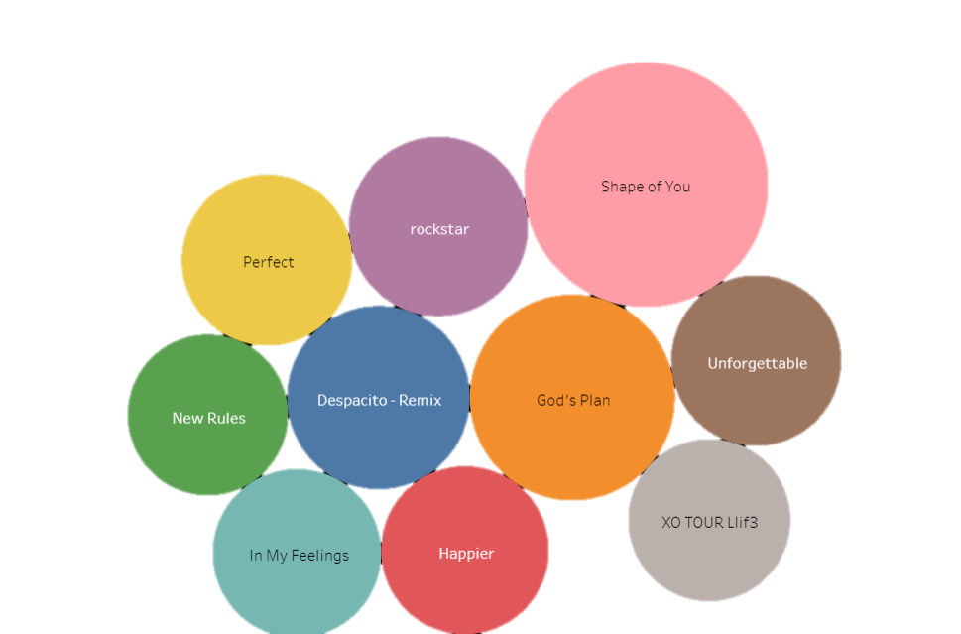
Most Popular Songs
Ed Sheeran’s “Shape of You” has over 4 billion streams!!

Slide 11
Conclusion
Decreasing in streaming over year from 2018 to 2019 shows various reasons - decreasing user base, shifting user behaviour, content availability.
Artist like Drake showed consistently in streaming and track. This will help other artist to know their strength and weakness and improve performance ranking and fan base.
Knowing top songs helps to know the user’s preferences over time.

Slide 12
Recommendation
Targeted Online Advertising
Influencer Marketing
Playlist Placement
Collaborations with Artists
Audio Ads
Targeted Email Marketing
Cross-Promotion with Brands
Continuously analysing the performance of advertisement campaign and making adjustment is necessary.

